Slide 1
Introduction to Physics-Informed Neural Networks
Enrico Schiassi, enrico.schiassi90@gmail.com

Slide 2
Agenda
Data-regression remarks
Neural Networks for data-regression
Data-driven training
Data-physics-driven training
Physics-driven training
Data-physics-driven training for parameter estimation
PINN applications

Slide 3
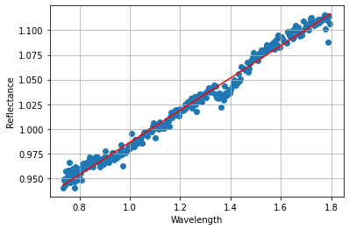
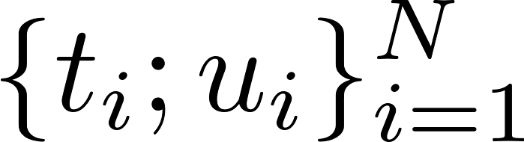

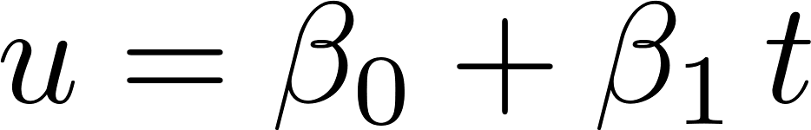
Data-regression remarks
Given a collection of data (input-output pairs):
Unknown mapping between the input t and the output u:
Goal: to find the best possible approximation of the true g.

Slide 4
Data-regression remarks
Given a collection of data (input-output pairs):
Unknown mapping between the input t and the output u:
Goal: to find the best possible approximation of the true g.
Question: what if the data were not following a linear trend?

Slide 5
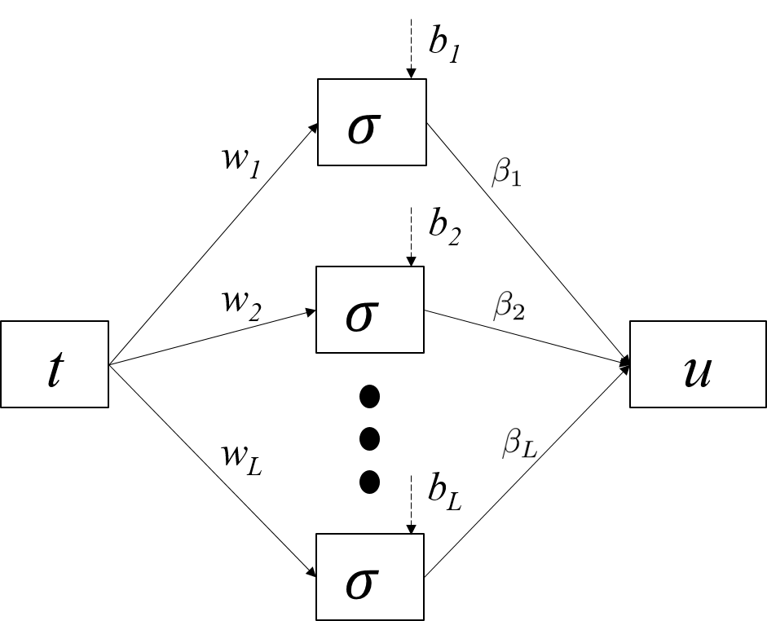
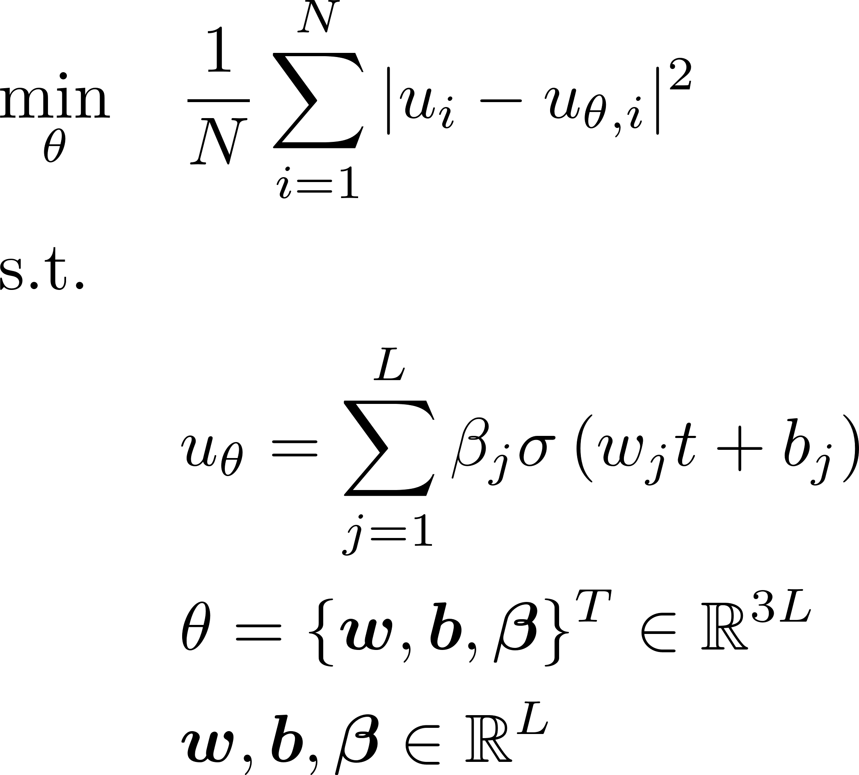
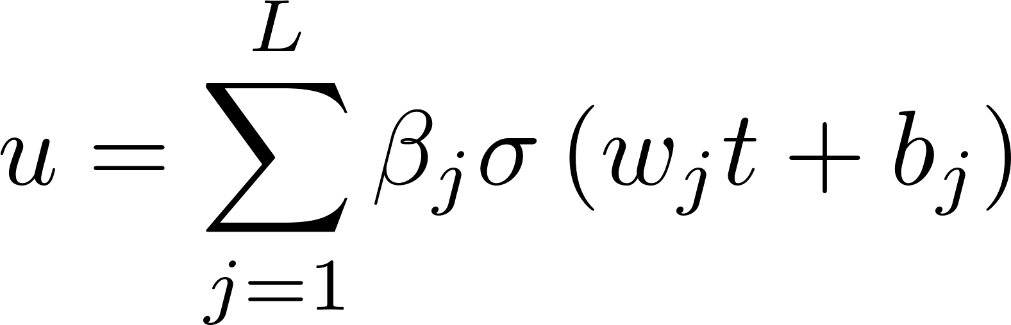
Neural Networks for data-regression
Given (labeled) data-set:
Shallow Single Input Single Output NN
Real unknown map to estimate:
Classic Neural Networks (NN)

Slide 6
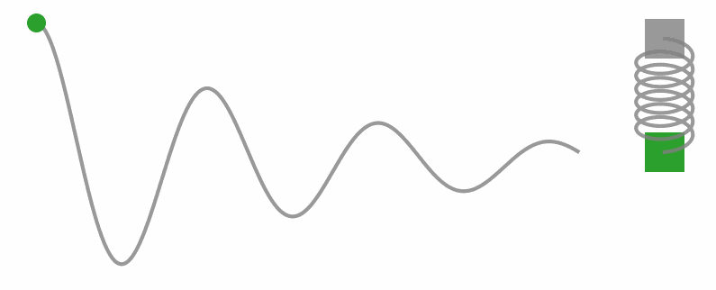
Data-driven training
The given (labeled) data-set is the only available information to drive the training:
https://benmoseley.blog/my-research/so-what-is-a-physics-informed-neural-network/
Classic Neural Networks (NN)

Slide 7
Data-driven training
The given (labeled) data-set is the only available information to drive the training:
https://benmoseley.blog/my-research/so-what-is-a-physics-informed-neural-network/
Classic Neural Networks (NN)
Question: what would happen if the data were missing/scarce or noisy?

Slide 8
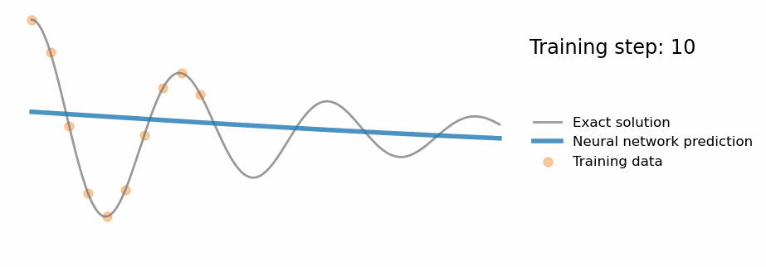
Data-driven training (cont’d)
https://benmoseley.blog/my-research/so-what-is-a-physics-informed-neural-network/

Slide 9
Data-driven training (cont’d)
https://benmoseley.blog/my-research/so-what-is-a-physics-informed-neural-network/
Question: how can this issue be avoided/mitigated?

Slide 10
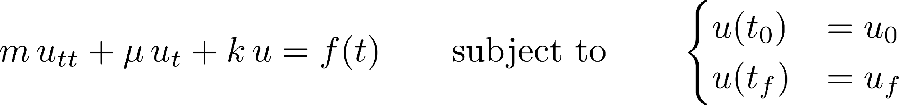
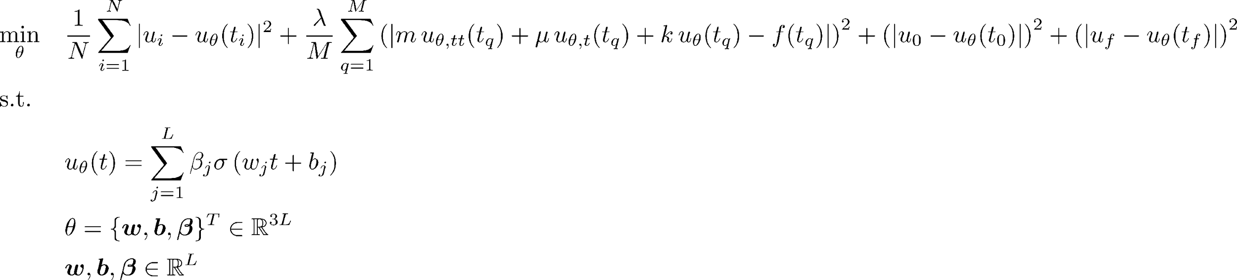
Data-physics-driven training
Given (labeled) data-set:
Physics, damped harmonic oscillator, modeled via the following Differential Equation (DE):
Physics-Informed Neural Networks (PINN):

Slide 11
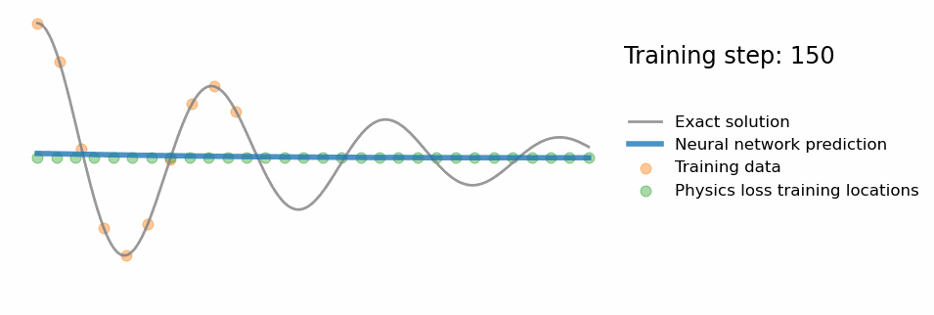
Data-physics-driven training (cont’d)
https://benmoseley.blog/my-research/so-what-is-a-physics-informed-neural-network/

Slide 12
Data-physics-driven training (cont’d)
Question: could PINNs be trained successfully with no labeled data?
https://benmoseley.blog/my-research/so-what-is-a-physics-informed-neural-network/

Slide 13
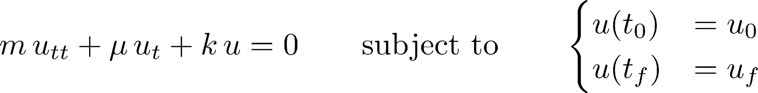
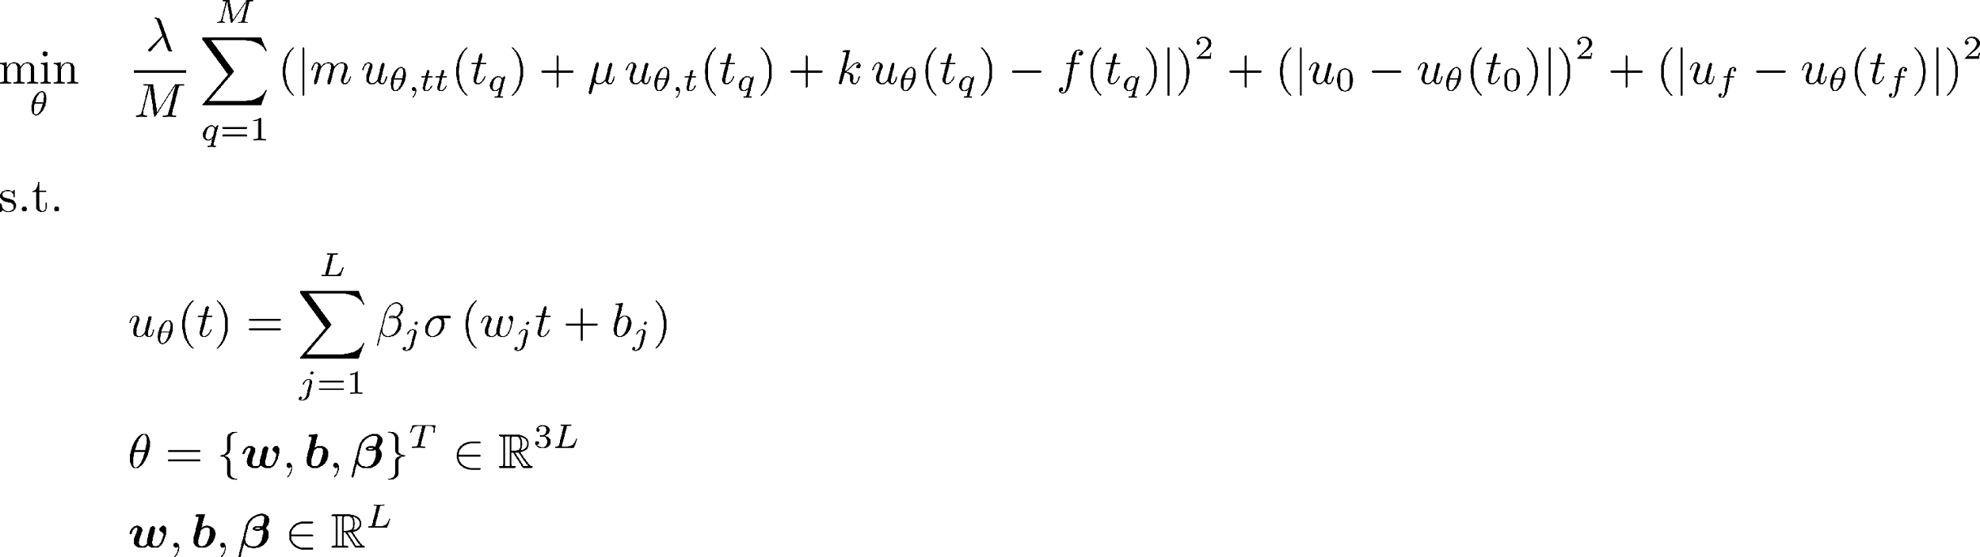
Physics-driven training
Physics, damped harmonic oscillator, modeled via the following DE:
Physics-Informed Neural Networks (PINN):

Slide 14
Physics-driven training
Physics, damped harmonic oscillator, modeled via the following DE:
Question: could PINNs be used with no full knowledge of the governing DE?
Physics-Informed Neural Networks (PINN):

Slide 15
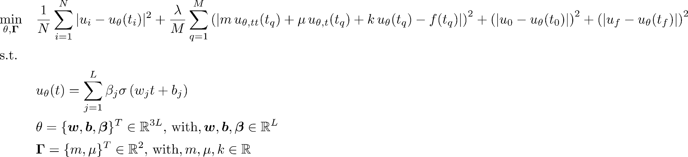
Data-physics-driven training for parameter estimation
Given (labeled) data-set:
Physics, damped harmonic oscillator, modeled via the following DE:
Physics-Informed Neural Networks (PINN):

Slide 16
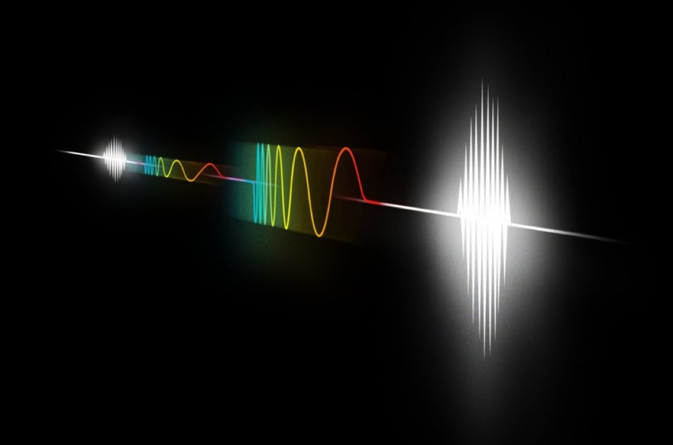
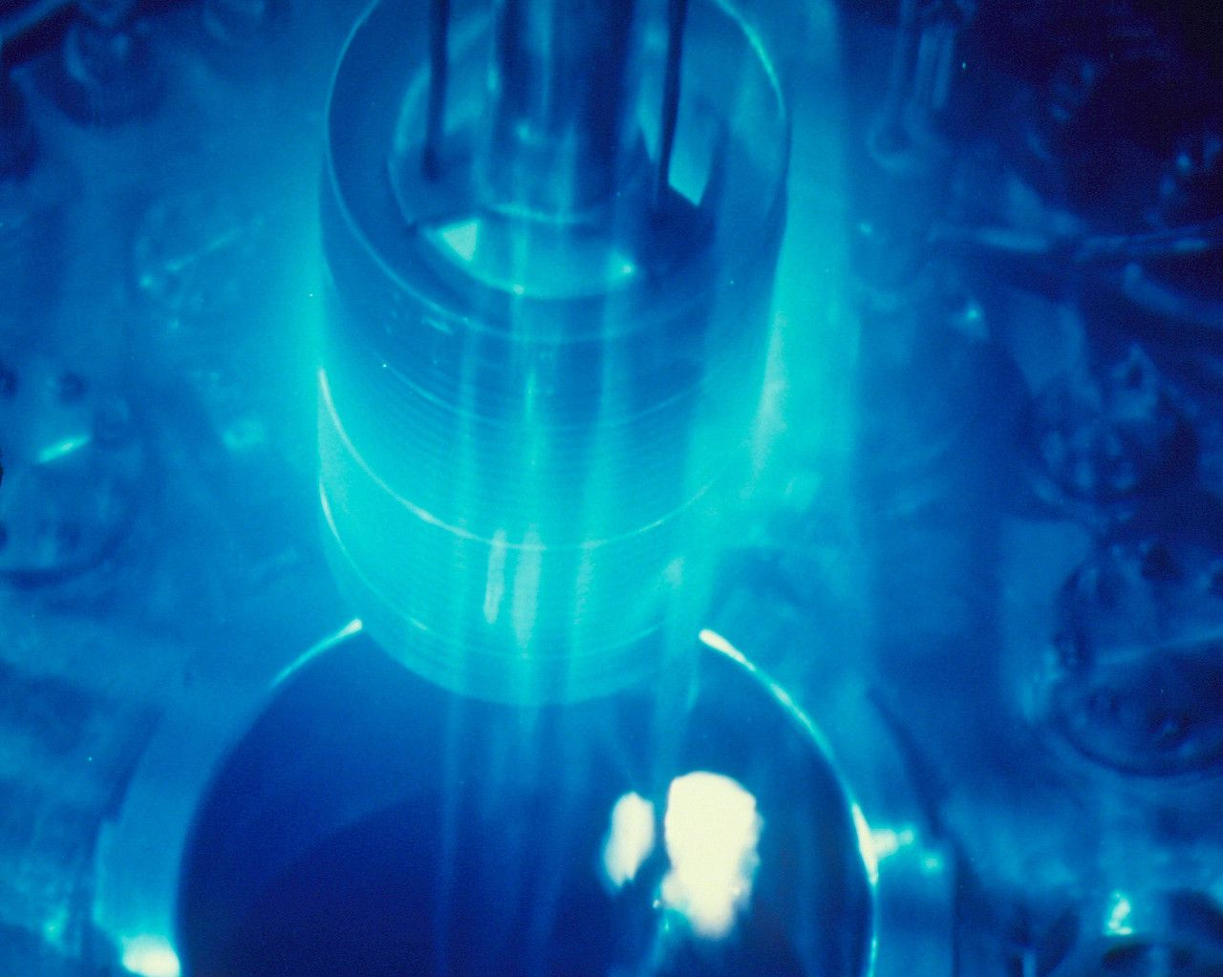
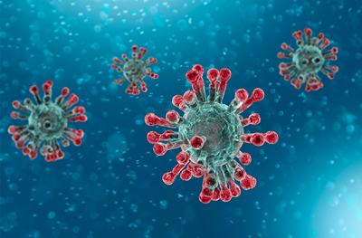


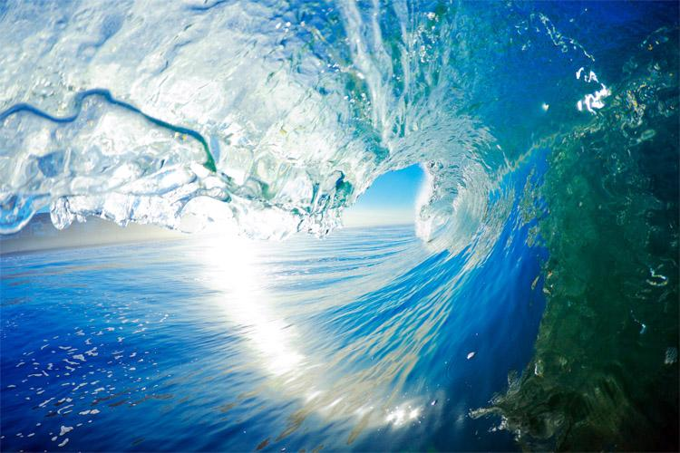
PINN applications
Many real-world problems are described by data constrained to follow physics laws modeled via DE
Physics, engineering, finance, biology, chemistry, oceanography, epidemiology, etc.
There is the need to have trustworthy tools to tackle these problems
PINNs can be used to tackle these problems
Forward problems, where the goal is to find the function governing the data
Inverse problems, where the goal is to find the function governing the data and estimate the DE parameters

Slide 17
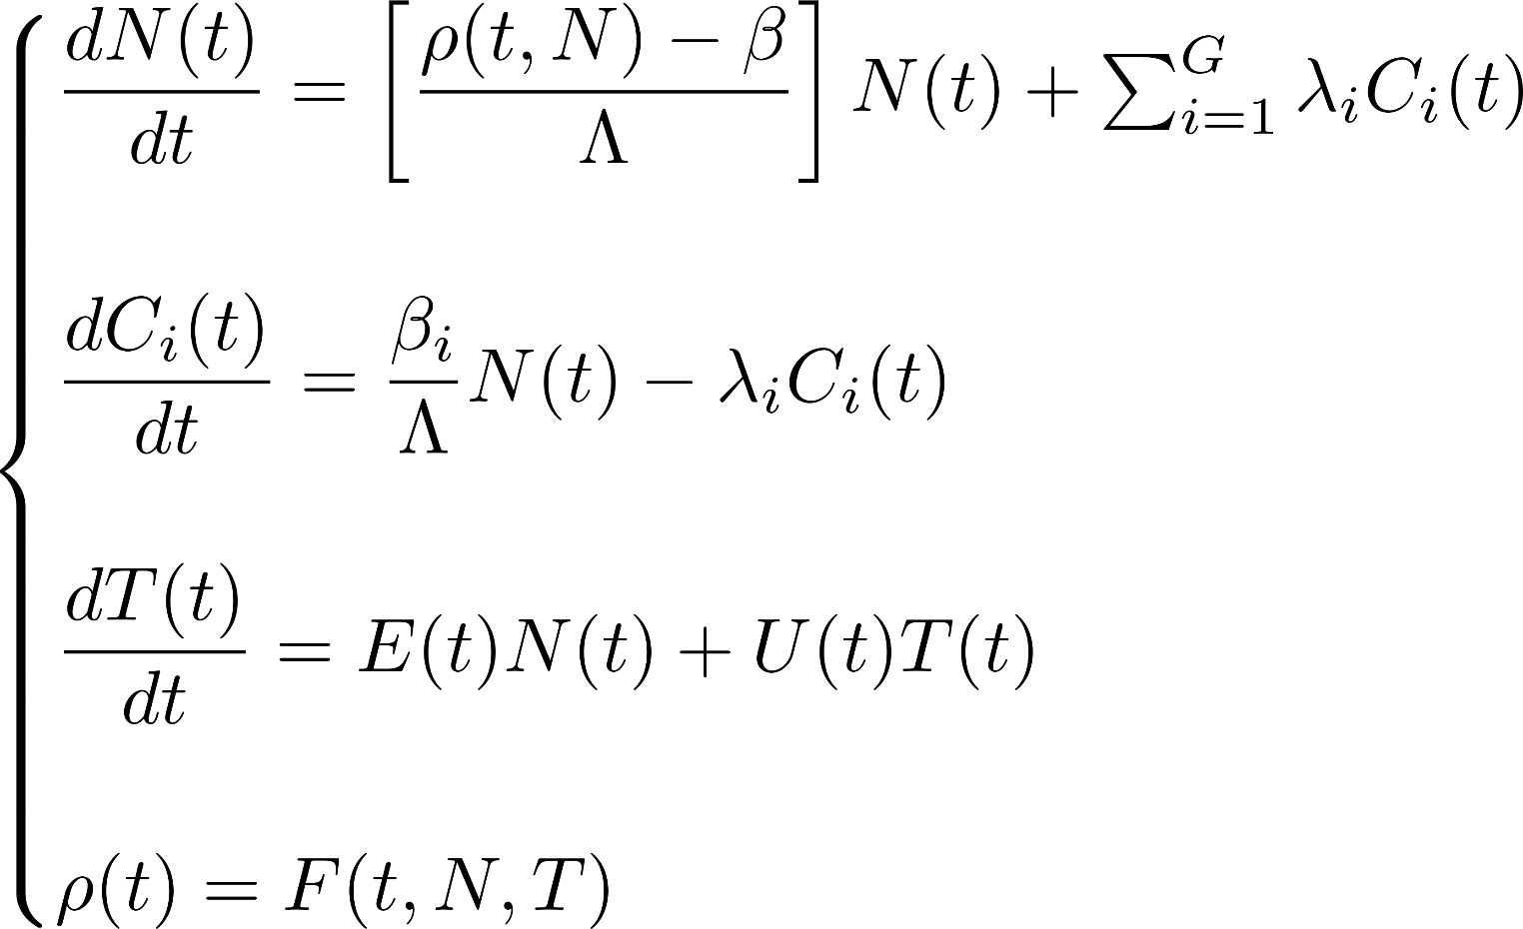
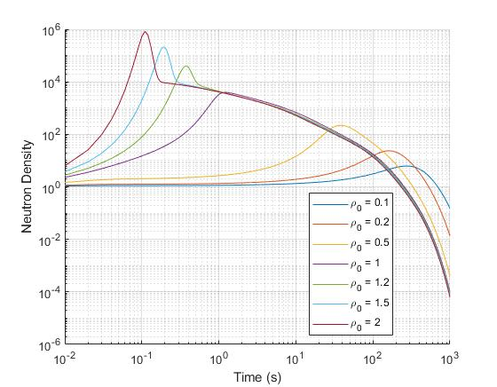
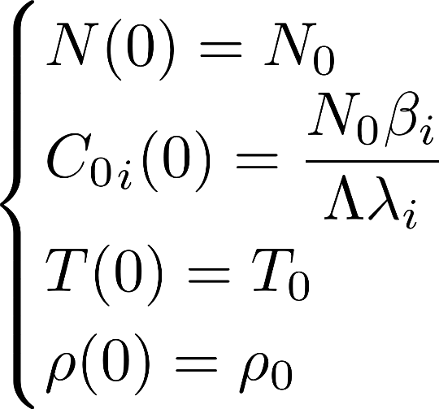
PINN applications (cont’d)
Point Kinetics Equations for nuclear reactor dynamics
Initial Conditions
Schiassi, E., De Florio, M., Ganapol, B.D., Picca, P. and Furfaro, R., 2022. Physics-informed neural networks for the point kinetics equations for nuclear reactor dynamics. Annals of Nuclear Energy, 167, p.108833. Vancouver

Slide 18
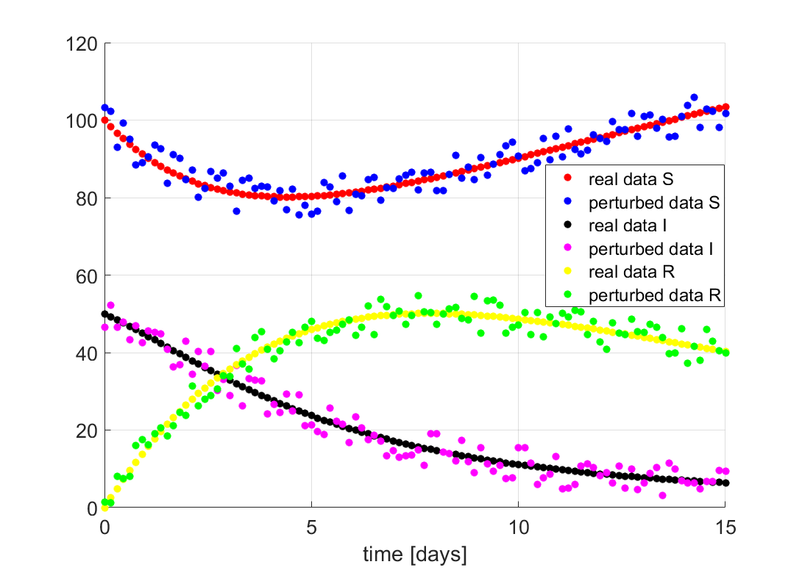
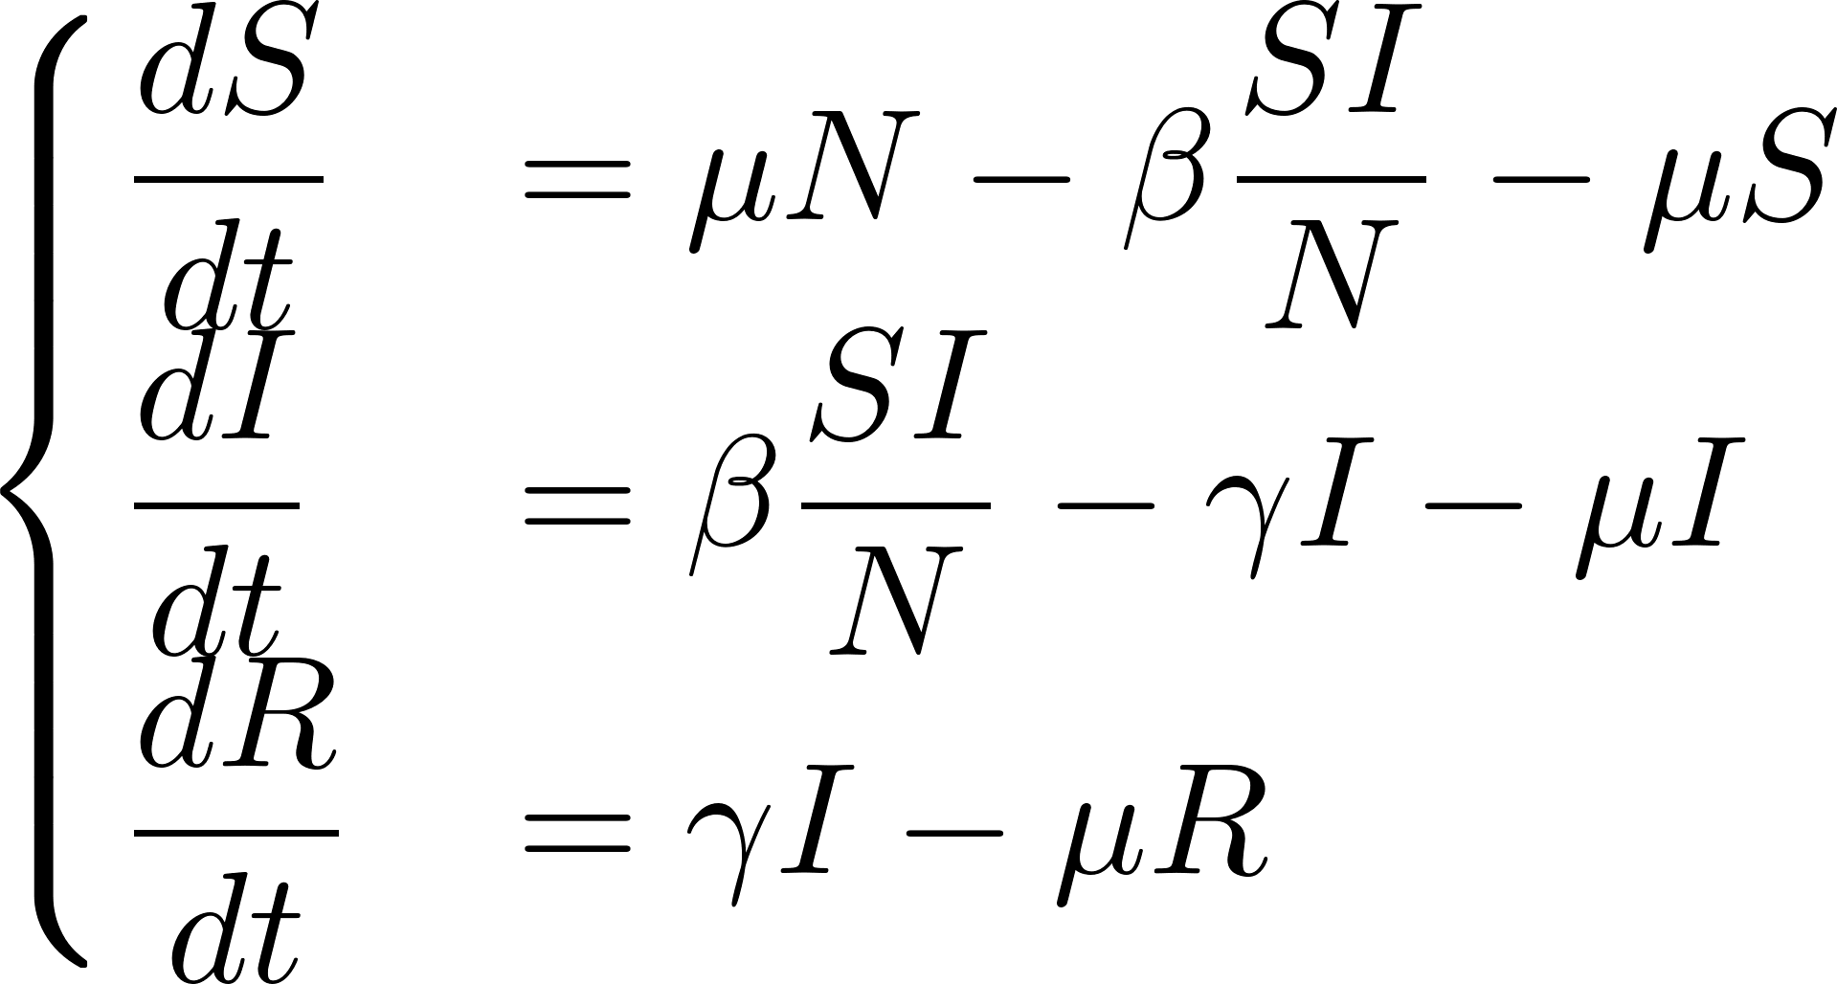
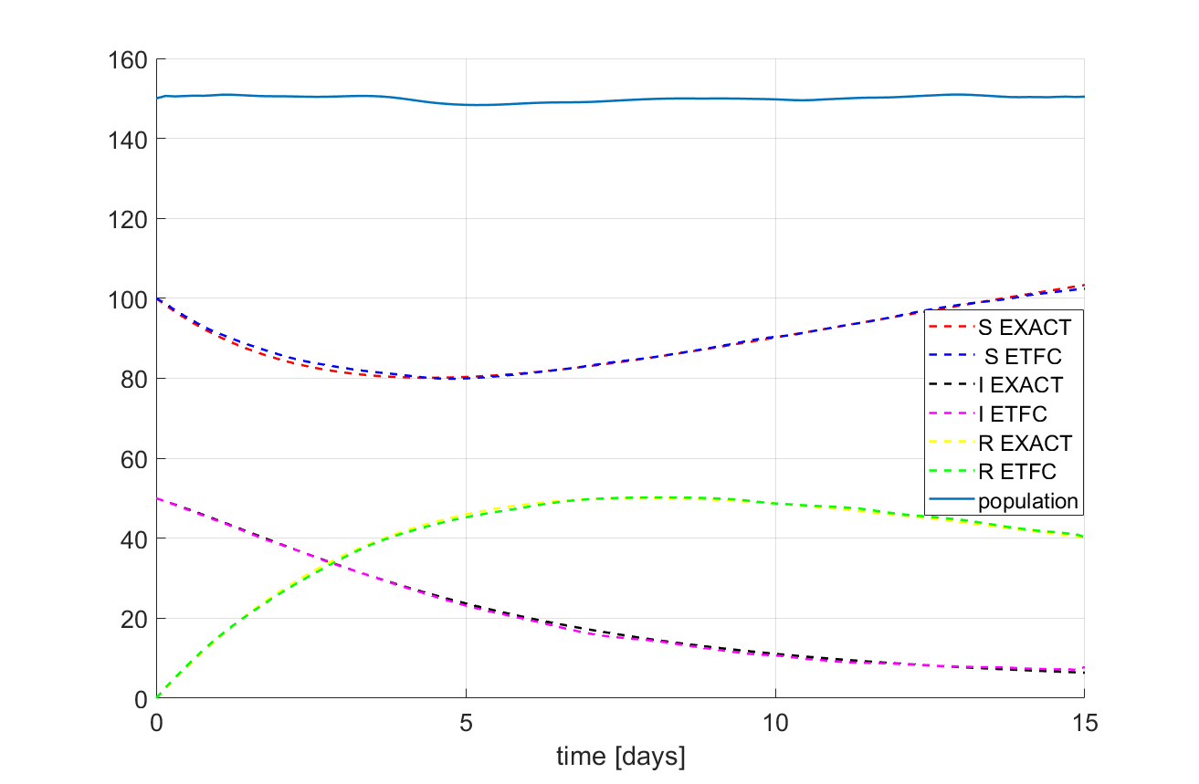
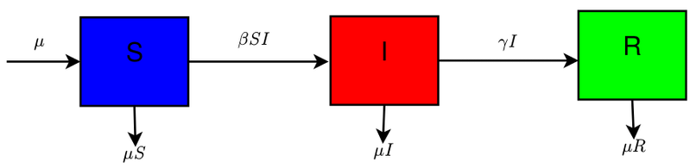
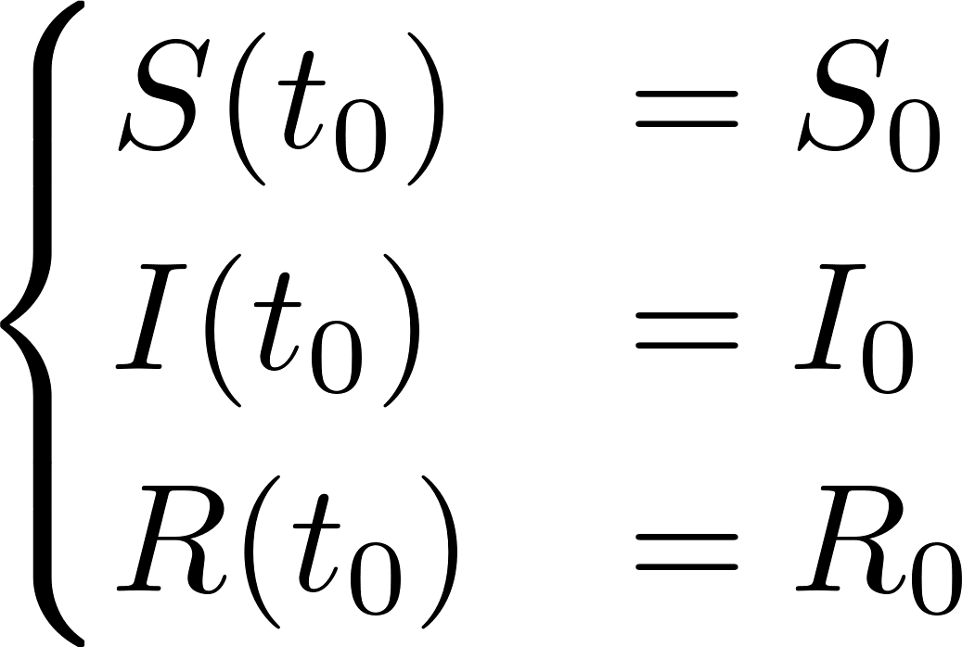
PINN applications (cont’d)
Epidemiological compartmental model for virus spread
Initial Conditions
Schiassi, E., De Florio, M., D’Ambrosio, A., Mortari, D. and Furfaro, R., 2021. Physics-informed neural networks and functional interpolation for data-driven parameters discovery of epidemiological compartmental models. Mathematics, 9(17), p.2069.

Slide 19
Thank you for your attention
Enrico Schiassi, enrico.schiassi90@gmail.com

